Slide 1
Lecture 7 - Linear Regression and Multiple Regression
Jibo He
Associate Professor
Wichita State University
Jibo.he@Wichita.edu

Slide 2
Chapter Outline
From Relationships to Predictions
Fundamentals of Linear Regression
What Makes the Regression Line the Best Fitting Line?
The Slope and y-Intercept of a Straight Line
Using the Method of Least Squares to Find the Best Fit
Using Analysis of Regression to Measure Significance
Using the Standard Error of Estimate to Determine Accuracy
Intro to Multiple Regression
Computing and Evaluating Significance for Multiple Regression
The β coefficient
Predictors
APA in Focus: Reporting Regression Analysis

Slide 3
From Relationships to Predictions
You can use the information provided by r to predict values of one factor, given known values of a second factor
Linear regression, also called regression – statistical procedure used to determine the equation of a regression line to a set of data points and to determine the extent to which the regression equation can be used to predict values of one factor, given known values of a second factor in a population

Slide 4
Fundamentals of Linear Regression
To use linear regression, identify two types of variables:
Predictor variable, or known variable (X) – the variable with values that are known and can be used to predict values of another variable
Criterion variable, or to-be-predicted variable (Y) – the variable with unknown values that can be predicted or estimated, given known values of the predictor variable
You can use linear regression to answer the following questions about the pattern of data points and the significance of a linear equation:
1. Is a pattern evident in a set of data points?
2. Which equation of a straight line can best describe this pattern?
3. Are the predictions made from this equation significant?

Slide 5
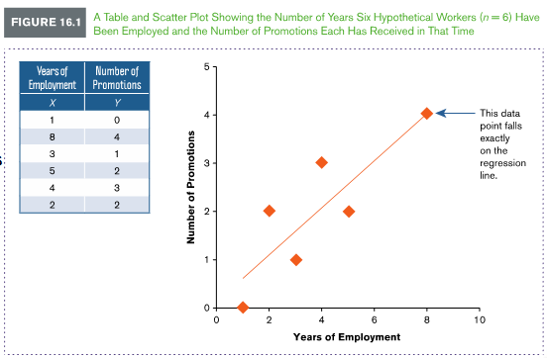
Example 16.1: Fundamentals of Linear Regression
Data is gathered from six employees to assess the relationship between length of employment and number of promotions. In graphing the data, a scatter plot of the predictor variable (years of employment) and criterion variable (promotions) seems to reveal a linear pattern. What questions can be asked to ensure that the correct equation for a straight line is calculated and if the predictions from this equation are significant?

Slide 6
Computing the Regression Line Using Sum of Squares (SS)
Once a linear pattern has been determined for a set of data points, we look for the regression line
The criterion used to determine the regression line is sum of squares (SS), or the sum of the squared distances of data points from a straight line
The line, associated with the smallest total value for SS, is the best fitting straight line, called the regression line

Slide 7
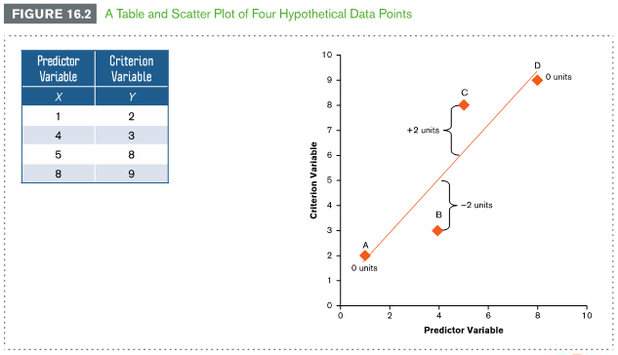
Example 16.2: What Makes the Regression Line the Best Fitting Line?
Suppose we measure two factors, one predictor variable plotted on the x-axis and one criterion variable plotted on the y-axis. Figure 16.2 shows hypothetical data for these two factors

Slide 8
Example 16.2: What Makes the Regression Line the Best Fitting Line? (cont.)
Data points A and D fall on the regression line
The distance of these data points from the regression line is 0
Data points B and C fall two units from the regression line
Data point B falls two units below (- 2) and data point C falls two units above (+ 2)
The sum of the distances is 0 + 0 + 2 – 2 = 0
To avoid a solution of 0, compute SS by squaring the distance of each data point from the regression line, then summing
The distance of these data points from the regression line is 0
When you square the distance of each data point and then sum, you obtain:
This is the smallest possible solution for SS
Any other line will produce a value of SS larger than 8

Slide 9
The Slope and y Intercept of a Straight Line
If we know the equation of the regression line and the values of X, we can predict values of Y
The equation of a straight line is:
The slope (b) of a straight line is used to measure the change in Y relative to the change in X. When X and Y change in the same direction, the slope is positive. When X and Y change in opposite directions, the slope is negative
Slope (b) = change in Y
change in X
Positive slope appears as if regression is going uphill, negative slope appears as if going downhill
The y-intercept (a) of a straight line is the value of Y when X = 0. It is where a straight line crosses the y-axis on the a graph
_________

Slide 10
Using the Method of Least Squares to Find the Best Fit
Method of least squares – statistical procedure used to compute the slope (b) and y-intercept (a) of the best fitting straight line to a set of data points
To use the method of least squares, complete three steps:
Step 1: Compute the preliminary calculations
Step 2: Calculate the slope (b)
Step 3: Calculate the y-intercept (a)

Slide 11
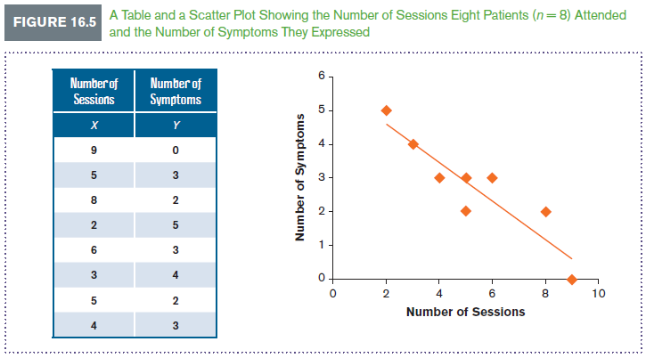
Example 16.3: Using the Method of Least Squares to Find the Best Fit
A psychologist wants to predict the effectiveness of a behavioral therapy (measured as the number of symptoms patients express), given the number of sessions a patient attends.
She selects a sample of eight patients who expressed the same number of symptoms at the start of treatment. She then records the number of sessions attended (X) and the number of symptoms expressed (Y) by each patient. Figure 16.5 shows the data for this study

Slide 12
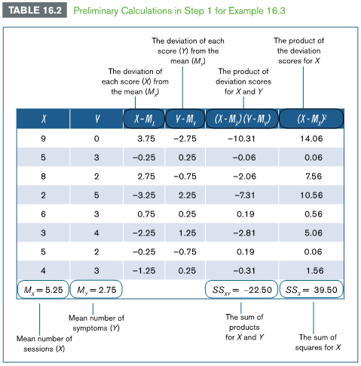
Example 16.3: Compute Preliminary Calculations
Step 1: Compute preliminary calculations.

Slide 13
Example 16.3: Compute Preliminary Calculations
Step 1: Compute preliminary calculations (cont.)
Compute the average X and Y score (Table 16.2, bottom rows of columns “X” and “Y”)
Subtract each score from its respective mean (Table 16.2, third and fourth columns)
Multiply and sum the deviation scores for X and Y (Table 16.2, multiply across rows of third and fourth columns)
(bottom row of fifth column)
Multiply and sum the deviation scores for X (bottom of sixth column)

Slide 14
Example 16.3: Calculate the Slope (b)
Step 2: Calculate the Slope (b)
The formula for computing slope (b) is:
= or
We already computed and

Slide 15
Example 16.3: Calculate the y-intercept (a)
Step 3: Calculate the y-intercept (a)
The formula for determining the y-intercept (a):
We already computed , , and
We can now state the equation of the least squares regression line
In this equation, is the predicted value of Y, given values of X
For example, suppose you want to make a prediction. If one patient has attended four therapy sessions (X = 4), we can substitute 4 into the equation
We would predict that a patient will express 3.46, or between 3 and 4, symptoms following four therapy sessions

Slide 16
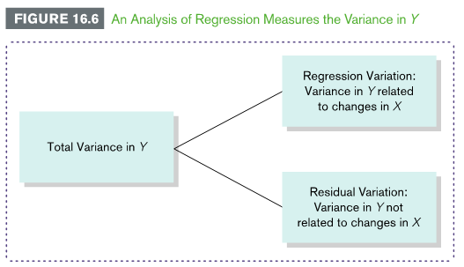
Using Analysis of Regression to Determine Significance
Analysis of regression, or regression analysis – statistical procedure used to test hypotheses for one or more predictor variables to determine whether the regression equation for a sample of data points can be used to predict values of the criterion variable (Y) given values of predictor variable (X) in the population

Slide 17
Using Analysis of Regression to Determine Significance (cont.)
We will follow the four steps to hypothesis testing using the data in Example 16.3
Step 1: State the hypotheses
H₀ : The variance in the number of symptoms expressed (Y) is not related to changes in the number of therapy sessions attended (X)
H₁ : The variance in the number of symptoms expressed (Y) is related to changes in the number of therapy sessions attended (X)
To evaluate hypotheses, we measure variance in Y that is and is not related to X.
Variance that is related to changes in X is called regression variation
Variance that is not related to changes in X is called residual variation
Analysis of regression measures only variance in Y, because that is what we want to predict.
Equal to total variance

Slide 18
Using Analysis of Regression to Determine Significance (cont.)
Step 2: Set the criteria for a decision
We will use a .05 level of significance
df for regression variation, or df numerator, are equal to the number of predictor variables
Because we have 1 predictor variable (X),
df for residual variation, or df denominator, are equal to the sample size minus 2
Because ,
The critical value is listed in Table B3 in Appendix B
The critical value is 5.99

Slide 19
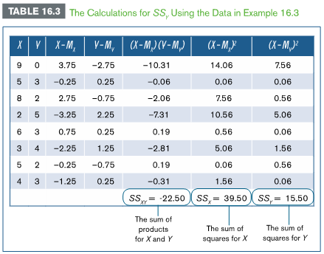
Using Analysis of Regression to Determine Significance (cont.)
Step 3: Compute the test statistic
Pearson correlation
_{Coefficient}
=-0.91

Slide 20
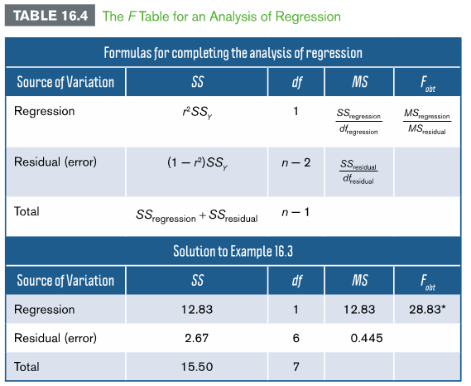
Using Analysis of Regression to Determine Significance (cont.)

Slide 21
Using Analysis of Regression to Measure Significance (cont.)
Step 4: Make a decision
Compare the value of the test statistic to the critical values
Because exceeds the critical value (5.99), we reject the null hypothesis
We conclude that the number of symptoms expressed (Y) is related to changes in the number of therapy sessions attended (X)
We can predict values of Y, given values of X in the population using the equation we computed using the method of least squares:

Slide 22
Using the Standard Error of Estimate to Measure Accuracy
Standard error of estimate ( ) – an estimate of the standard deviation or distance that a set of data points falls from the regression line. The standard error of estimate equals the square root of the mean square residual
In Example 16.3, the mean square residual was 0.445 (see Table 16.4), hence the standard error of estimate is

Slide 23
Simple Linear Regression in R
#simple linear regression
NSession <-c(9,5,8,2,6,3,5,4)
NSymptom<-c(0,3,2,5,3,4,2,3)
lm.r = lm(NSymptom ~ NSession)
summary(lm.r)
coef(lm.r) # gives the model’s coefficients

Slide 24
Multiple Regression
Multiple regression – statistical method that includes two or more predictor variables in the equation of a regression line to predict changes in a criterion variable
To accommodate more predictor variables in the equation of a regression line, add the slope, b, and the predictor variable, X, for each addition variable
[1] (one predictor variable)
[2] (two predictor variables)
[3] (three predictor variables)
One advantage of including multiple predictors in the regression equation is that we can detect the extent to which two or more predictor variables interact

Slide 25
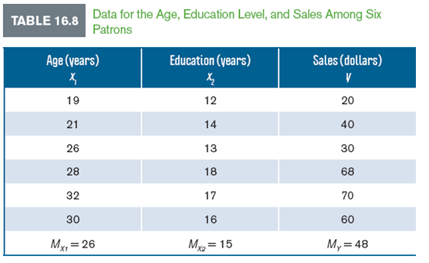
Computing and Evaluating Significance for Multiple Regression
Interest in examining factors that can predict customer spending and behavior led to a study in which researchers investigated if age and education level (years of education) could predict sales (dollars spent). Use the data below to compute a regression equation for predicting sales and test if the equation can significantly predict sales at a .05 level of significance.

Slide 26
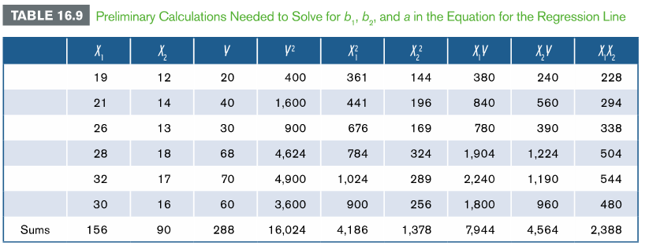
Computing and Evaluating Significance for Multiple Regression (cont.)
To solve for equation, we need to calculate b₁, b₂ and a

Slide 27
Computing and Evaluating Significance for Multiple Regression (cont.)
Compute the multiple regression equation

Slide 28
Computing and Evaluating Significance for Multiple Regression (cont.)
The multiple regression equation is then…

Slide 29
Computing and Evaluating Significance for Multiple Regression (cont.)
Evaluate the significance of the multiple regression equation: Complete the F table
Step 1: State the hypotheses.
H₀: The regression equation does not significantly predict variance in sales
H₁: The regression equation does significantly predict variance in sales
Step 2: Set the criteria for a decision
.05 level of significance
df for regression variation is 2 (2 predictor variables); df for residual variation is 3 (sample size minus 3)
Critical value is 9.55 (Table B.3, appendix B)

Slide 30
Computing and Evaluating Significance for Multiple Regression (cont.)
Step 3: Compute the test statistic
First compute SS and then complete F table
Enter the above values into the F table

Slide 31
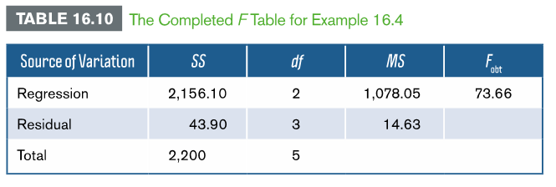
Computing and Evaluating Significance for Multiple Regression (cont.)
Step 4: Make a decision
exceeds critical value (9.55); thus, reject the null hypothesis

Slide 32
The β Coefficient and Evaluating Significance of Predictors for Multiple Regression
We can consider the relative contribution of each factor by answering two questions…
Is one of the predictor variables a better predictor?
Consider values of beta coefficients. These can be influenced by outside factors; thus, we standardize the coefficients.
We do so by converting the beta coefficients to z scores and recomputing
The standardized b scores are now symbolized as β
The greater the β score, the more influence the factor has in predicting values of Y
When we compute the standardized coefficients,
we obtain:

Slide 33
The β Coefficient and Evaluating Significance of Predictors for Multiple Regression (cont.)
Does one predictor significantly increase prediction of Y?
Does X₁ contribute to predicting variance in Y beyond that already predicted by X₂?
Does X₂ contribute to predicting variance in Y beyond that already predicted by X₁?
We will analyze using the values from Ex. 16.4
Step 1: Find r² for the “other” predictor variable
Step 2: Identify SS accounted for by the predictor variable of interest
Complete the F table and make a decision

Slide 34
The β Coefficient and Evaluating Significance of Predictors for Multiple Regression (cont.)
Step 1: the “other” predictor is the one not being tested
; For X₁ in example 16.4:
Thus, r² = .966
Step 2: Identify SS
SS_{Y} predicted by
SS_{Y} predicted by
For X₁ in ex. 16.4: SS_{Y} predicted by X₂ alone:
SS_{Y} predicted by X₁ alone:

Slide 35
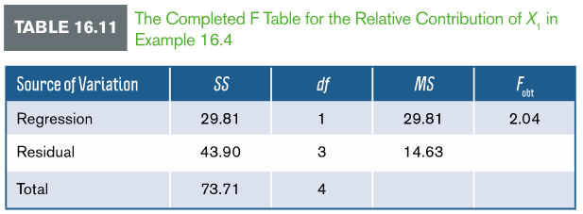
The β Coefficient and Evaluating Significance of Predictors for Multiple Regression (cont.)
Step 3: Complete F table and make a decision
Now testing only one predictor, df becomes 1 and 3.
Critical value is 10.13
With X₁ as the predictor variable, F = 2.04; thus we retain the null.
Adding X₁ to the regression equation does not significantly improve variance in Y compared to variance already predicted by X₂ alone

Slide 36
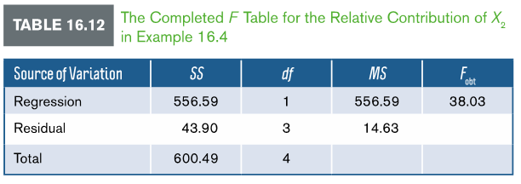
The β Coefficient and Evaluating Significance of Predictors for Multiple Regression (cont.)
The same steps can be carried out to analyze the relative contribution of the other factor by substituting X₂ in for the factor of “interest” and replacing the “other” factor with the values of X₁
In doing so for Ex. 16.4 (contribution of X₂), the resulting F table would be as follows…
In this scenario, the Fobt exceeds the critical value, thus we reject the null

Slide 37
Multiple Regression in R
Age <-c(19,21,26,28,32,30)
Education <-c(12,14,13,18,17,16)
Sales <-c(20,40,30,68,70,60)
# Create the relationship model.
model <- lm(Sales~Age+Education)
# Show the model.
print(model)
summary(model)

Slide 38
APA in Focus: Reporting Regression Analysis
To summarize an analysis of regression involving a single predictor variable, report the test statistic, df, and p value
Reporting r alone is sufficient
The data points for each pair of scores are often summarized in a scatter plot or figure displaying the regression line
The regression equation can be stated in the scatter plot

Slide 39
APA in Focus: Reporting Regression Analysis
To summarize results of multiple regression
Add the standardized β coefficient for each factor that significantly contributes to the prediction
Scores (X₁, X₂ and Y) are often summarized in a scatter plot displaying the regression line and the appropriate multiple regression equation
To illustrate, we summarize the results from Ex. 16.4…
An analysis of multiple regression showed that with age and education level as predictor variables, sales (in dollars) can be significantly predicted, . However, education , but not age , significantly contributed to predictions made with both factors included in the regression equation.

